Slide 1
Programming for Data Analysis (CT127-3-2-PFDA and Version VC1)
Introduction and Overview

Slide 2
Lecturer information
Lecturer Name:Minnu Helen Joseph
Email: minnu.helen@apu.edu.my
Telephone Extension:

Slide 3
Pre-requisites for this module
Fundamentals of Software Development or equivalent

Slide 4
Aims of this module
This module will explore the programming language used for problem-solving within the field of data science. The programming language will be used to analyze a set of data and reconstruct it into meaningful representations for decision making

Slide 5
Course Learning outcomes, CLOs
At the end of this course, YOU should be able to:
Reproduce appropriate structured data using data exploration, manipulation and transformation techniques
Analyze the dataset with appropriate techniques to solve a particular problem
Explain the obtained results through shareable reports

Slide 6
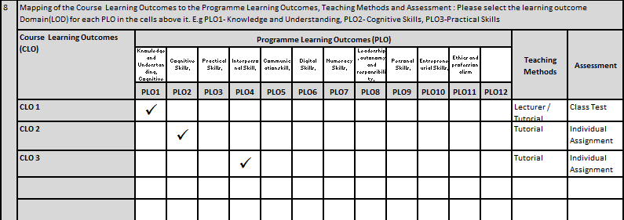
Mapping of CLOs with MOEs Domain
PLO1 – Knowledge and Understanding
PLO2 – Cognitive Skills
PLO4 – Interpersonal Skill

Slide 7
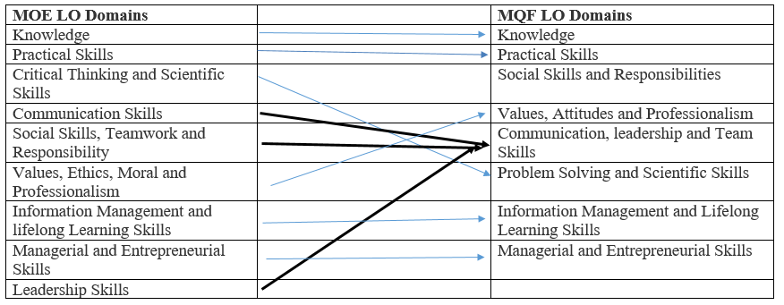
MQF and MOE Domains

Slide 8
Teaching Strategies
Lecture
Tutorial

Slide 9
Assessment Methods
Class Test (25%) : CLO1
Individual Assignment (75%)
Design and implement an application : CLO2
Presentation: CLO3
**refer to SAIS for details

Slide 10
Student Learning Time (SLT)
Course Credit Value: 3
Total Learning Hours:
Lecture : 28 hours per semester
Tutorial : 28 hours per semester
Independent Learning Time: 64 hours

Slide 11
Methods of Delivery
Hence,
We are now moving from the traditional topic based teaching to outcome-based education

Slide 12
Outcomes Based Education (OBE)
OBE is education based on producing particular educational outcomes that:
Focus on what students can actually do after they are taught
Expect all learners / students to successfully achieve particular (sometimes minimum) level of knowledge and abilities.

Slide 13
So…What is OBE?
It’s
NOT
What we want to teach,
It’s
What You should learn

Slide 14
Course Content Outline
CLO1 : Class Test (25%)
Lecture
Basics of R
Packages
Control Statements and Loops
Data Structures
Functions

Slide 15
Course Content Outline
CLO2 & CLO3 : Individual Assignment (75%)
Tutorial / Lecture
Data Exploration
Data Manipulation
Data Transformation
Data Visualization

Slide 16
What is expected of you
What is expected of you
You should abide to all the rules & regulation of APU
Proper attire
No speaking of dialects
Attendance is compulsory and valid medical certificates or letters from parents /guardians must support any absence from class.
Three lateness will be equal to one absence
All pagers and handphones should be turned off during lectures.

Slide 17
What support is available for you
Consultation hours
Resources
Reference material
Essential Reading
Lander, J. P. (2017) R for Everyone: Advanced Analytics and Graphics. 2nd ed. USA: Pearson Education, Inc. ISBN-13: 978-0134546926
MCGrath, M. (2018) R for Data Analysis in easy steps - R Programming essentials, UK:In Easy Steps Limited. ISBN-13: 978-1840787955
Morgan, P. (2018) Data Science from Scratch with Python: Step-by-Step Guide. 2nd ed. USA: CreateSpace Independent Publishing Platform. ISBN-13: 978-1726020688
Internet resources
Software : RStudio

Slide 18
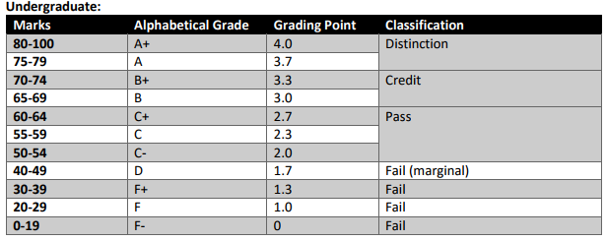
Achievement requirements

Slide 19
Question and answer session
Q & A

Slide 20
What we will cover next
Programming Environment and Package Installation

